Slide 1
計算機概論實習
Week 12 (2020/12/01)
指標Part2
Lab: EC 118
助教:
陳作源 russchen.cs08g@nctu.edu.tw
陳彥銨 my91015.cs08g@nctu.edu.tw
鄭智仁 king601012003.cs08g@nctu.edu.tw

Slide 2
Homework
We use 2 arrays A and B to store book titles in the library.
Each element of the array holds one book title. We will write a main() program to add, delete, or exchange elements of A and B repeatedly.
main() first reads 2 positive integers, m and n.
main() dynamically allocates an array of m elements. Each element is a pointer to a char array. This is the A array.
main() dynamically allocates an array of n elements. Each element is a pointer to a char array. This is the B array.

Slide 3
Homework (cont.)
main() then reads a integer p (p=0, 1, or 2) to choose your operation.
p=0 is for adding a book.
First read 3 integer x, y, and s.
x should be 0 or 1 to choose array A or B.
y is the index of the array and it should be empty, otherwise stop this operation. If y is out of bound should stop too.
s is the size of your book title ready to input.
If this operation doesn’t stop, then dynamically allocate a char array with size s, and input the string.
Then store the string to the chosen index of the chosen array.

Slide 4
Homework (cont.)
main() then reads a integer p (p=0, 1, or 2) to choose your operation.
p=1 is for deleting a book.
First read 2 integer x and y.
x should be 0 or 1 to choose array A or B.
y is the index of the array. If y is out of bound, stop this operation.
Then delete the string in the chosen index of the chosen array.

Slide 5
Homework (cont.)
main() then reads a integer p (p=0, 1, or 2) to choose your operation.
p=2 is for exchanging a book.
First read 2 integer x and y.
x is the index of the array A.
y is the index of the array B.
Either x or y is out of bound should stop this operation.
Then exchange 2 chosen strings.

Slide 6
Homework (cont.)
After every operation, you should print out every book titles in array A and B.
You don’t need to set the exit condition. That is, you can use while(1) loop to do operations eternally.

Slide 7
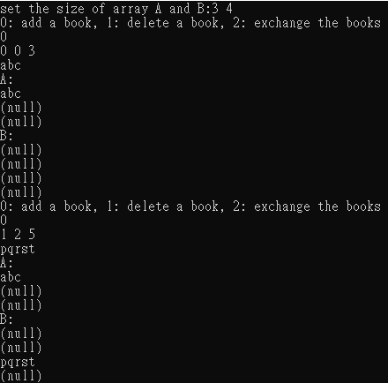
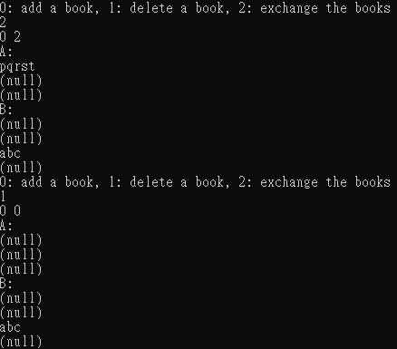
Homework Sample
3 5
0
0 2 6
asdfg

